Slide 1

How to manage & present scientific data
L. Nelson Sanchez-Pinto
PALSIS CRC
Sept. 4th, 2024

Slide 2

Before we start, some context
This is a compendium of common best practices (but not all)
It’s useful for data big and small (but biased towards bigger)
We will not discuss data analysis (which depends on the topic)
You can download this slides + resources:
https://github.com/nsanchezpinto/Presenting-Scientific-Data

Slide 3
Data management 101

Slide 4
My basic rules of data management
A clinical researcher that doesn’t have data skills is like a bench researcher that doesn’t have pipetting skills
If you’re collecting data, use a proper data collection tool (REDCap, not Excel)
Use open-source software and formats (R & .csv, not SAS & .sas) for data management and analysis
All methods and analyses should be reproducible (preferably using open-source code)
Keep clinical data secured, encrypted, de-identified (if possible), and with back up copies

Slide 5
Clinical data usually comes in 2 formats
subject_id | age_mo | sex | admission | discharge | died
A1 | 3 | M | 11/22/24 | 11/28/24 | 0
B2 | 12 | F | 03/30/24 | 04/05/24 | 1
C3 | 23 | F | 04/05/24 | 04/09/24 | 0
Wide format
subject_id | timestamp | lactate
A1 | 01:20 | 2.1
A1 | 05:30 | 2.8
A1 | 12:25 | 3.6
B2 | 05:50 | 5.2
B2 | 12:55 | 7.3
C3 | 14:20 | 2.4
C3 | 15:30 | 2.2
Long format

Slide 6
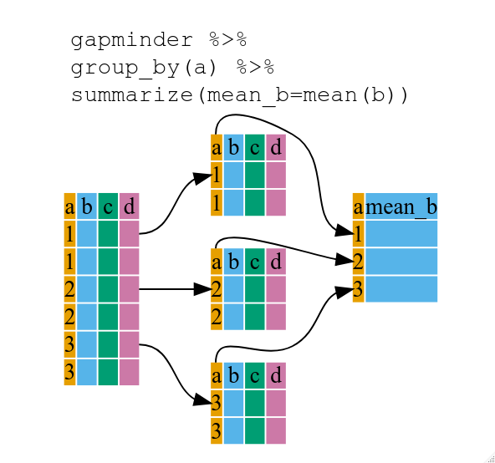
Often, we need to “summarize” long format tables
Statistical summaries:
Min, Max
Mean, Median
First, Last
…
subject_id | max_lactate
A1 | 3.6
B2 | 7.3
C3 | 2.4

Slide 7
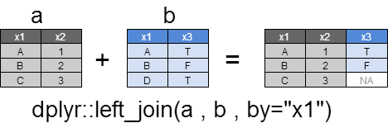
Often, we have to “join” tables to create datasets ready for analysis
subject_id | age_mo | sex | died | max_lactate
A1 | 3 | M | 0 | 3.6
B2 | 12 | F | 1 | 7.3
C3 | 23 | F | 0 | 2.4
ready for analysis!

Slide 8
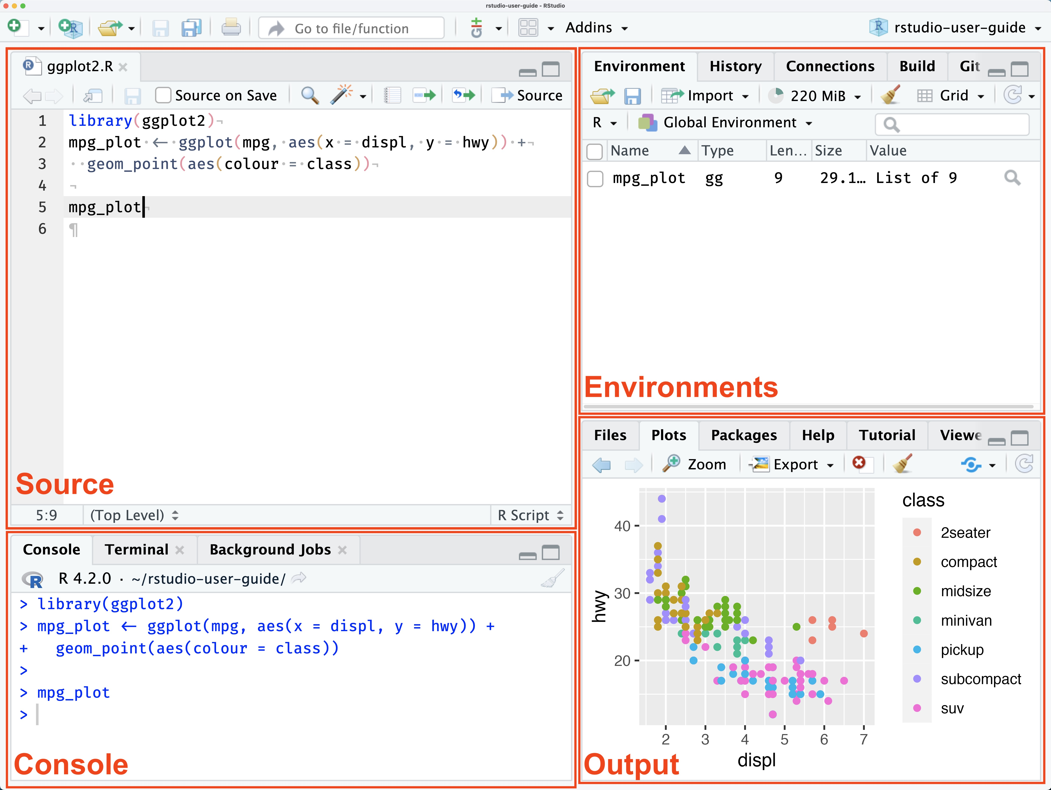

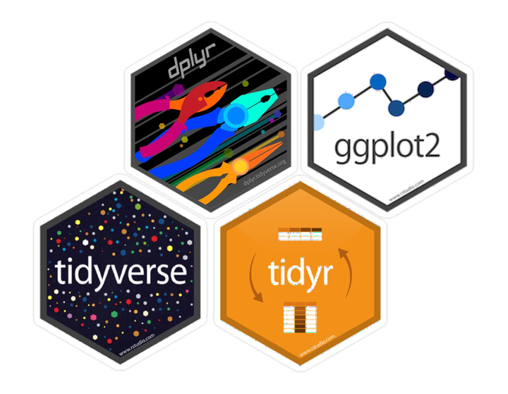
Use a reliable data management and analysis tool

Slide 9
How to present your
scientific data

Slide 10
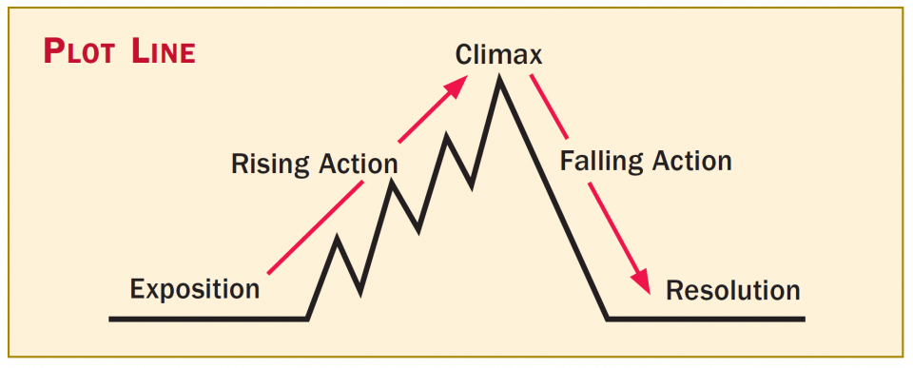
1. Tell a story with your data and provide context
Data talks and nobody walks!
Start general (set context) and then get specific (main finding)
Main finding(s)
Table 1
Sensitivity analyses
Methods
Secondary findings
Introduction
Discussion

Slide 11
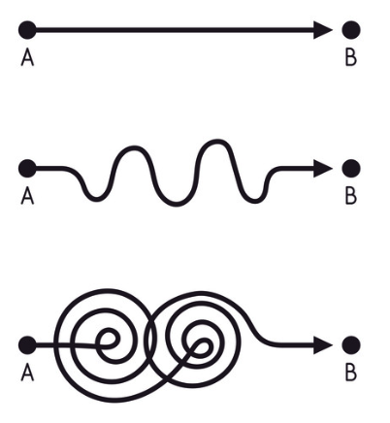
2. Keep it simple
What data is sufficient to tell your story?
Trim it down, but don’t take out important negative/refuting results.
Use the Supplement for the “superreaders”
In the main text, make sure you answer your research question (no more, no less)

Slide 12

3. Put different data where it belongs
Text is good for interpretation of data and contextualizing
Tables are good for showing precise/absolute numbers
Figures are good for showing proportions and trends
AVOID REPEATING THE SAME DATA
IN MORE THAN ONE PLACE

Slide 13


4. Data in text is tricky, but important
Provide interpretation, but not discussion nor viewpoints
Instead of:
“Before the implementation the length of stay was 5.4 days (IQR 4.2 - 6.5) and after the implementation it was 4.8 days (IQR 3.8-5.8), p<0.001.”
Use:
“Implementation was associated with a significant reduction in length of stay (Table X).”
But don’t use:
“Surprisingly, implementation was associated with a longer length of stay (Table X).”
Don’t qualify change (e.g. “increased after”) or differences (e.g. “higher than”) unless you prove it (i.e. it’s statistically significant)

Slide 14
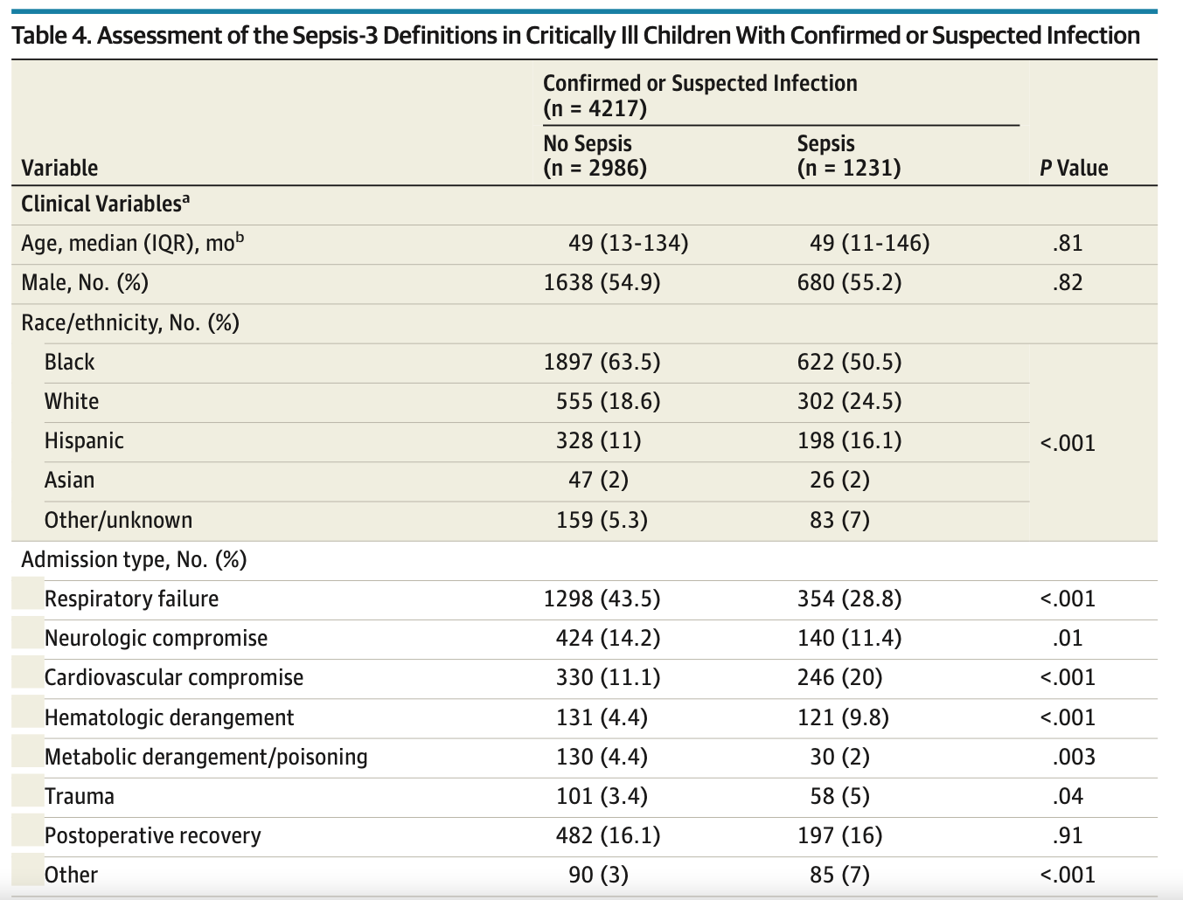
5. Tables are all about formatting, when in doubt, use the JAMA format

Slide 15
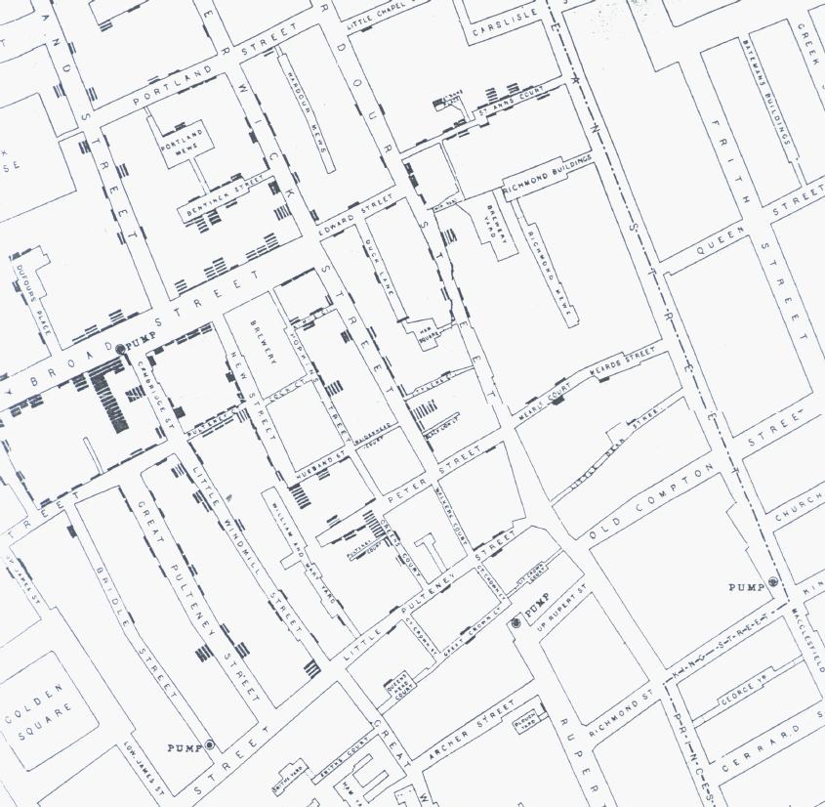
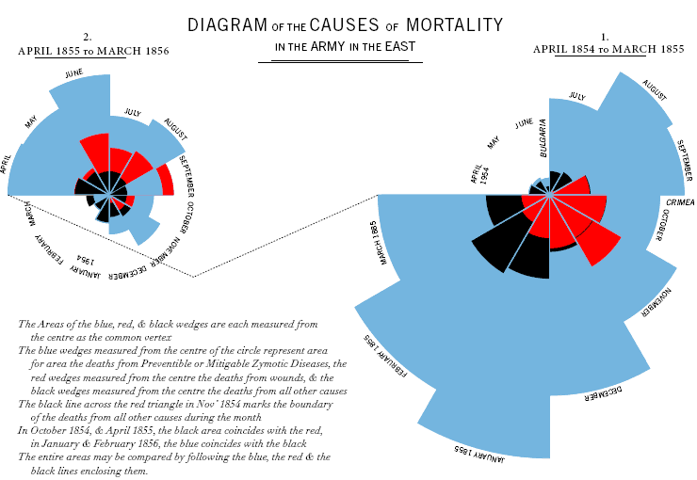
6. Figures convey information like no other medium

Slide 16
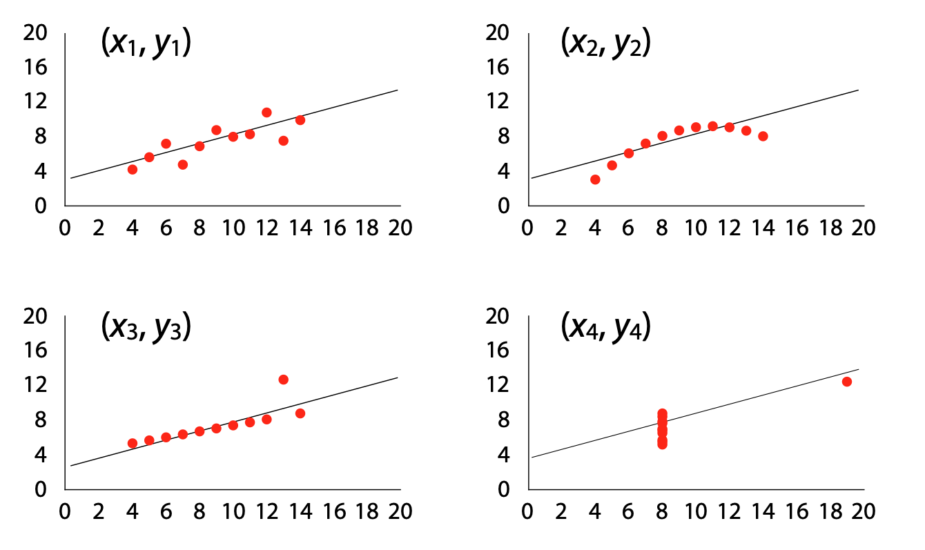
6. Figures convey information like no other medium

Slide 17
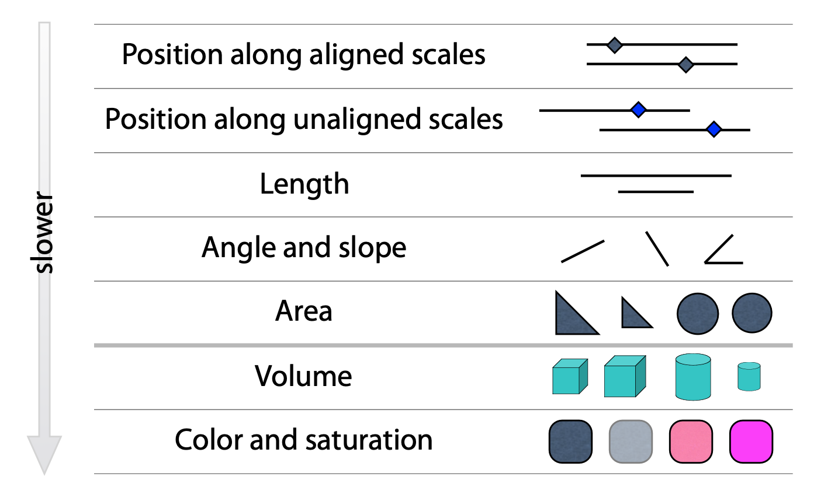
6.1. Figures: use position, color, and shapes effectively
Minimize cognitive load
Be thoughtful about color

Slide 18
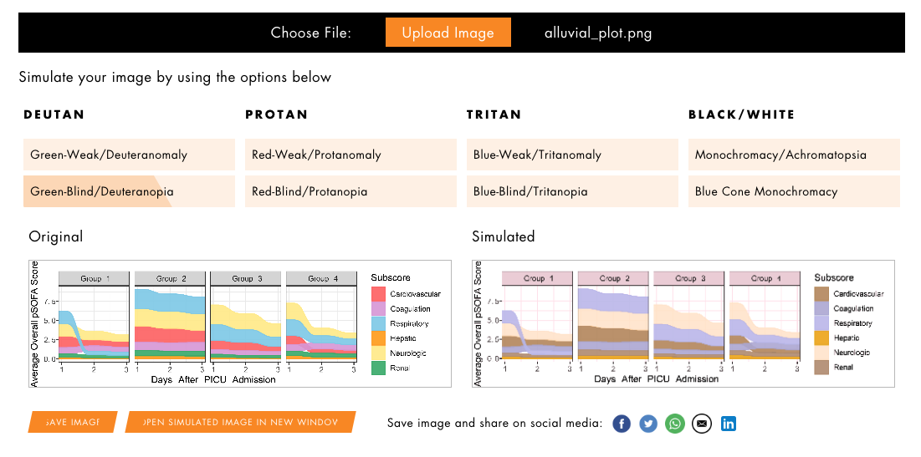
6.1. Figures: use position, color, and shapes effectively
https://pilestone.com/pages/color-blindness-simulator-1

Slide 19
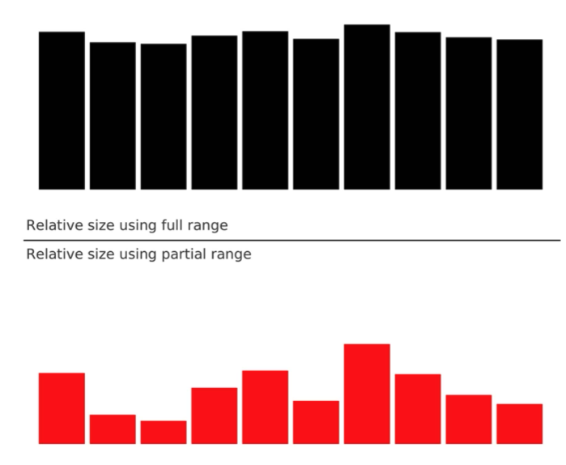
6.2. Figures: use captions and don’t mislead the reader
100
0
100
80

Slide 20
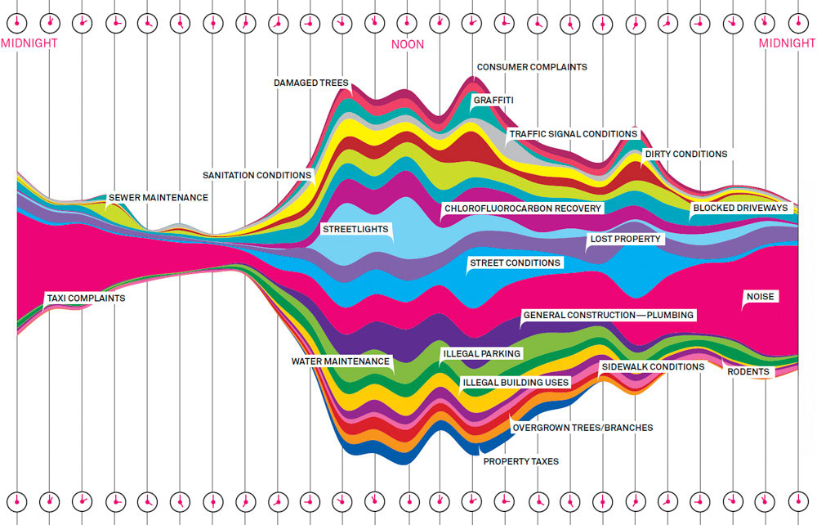
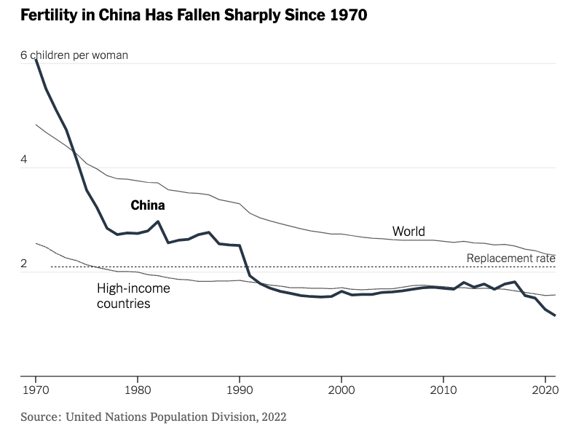
6.3. Figures: message trumps beauty

Slide 21
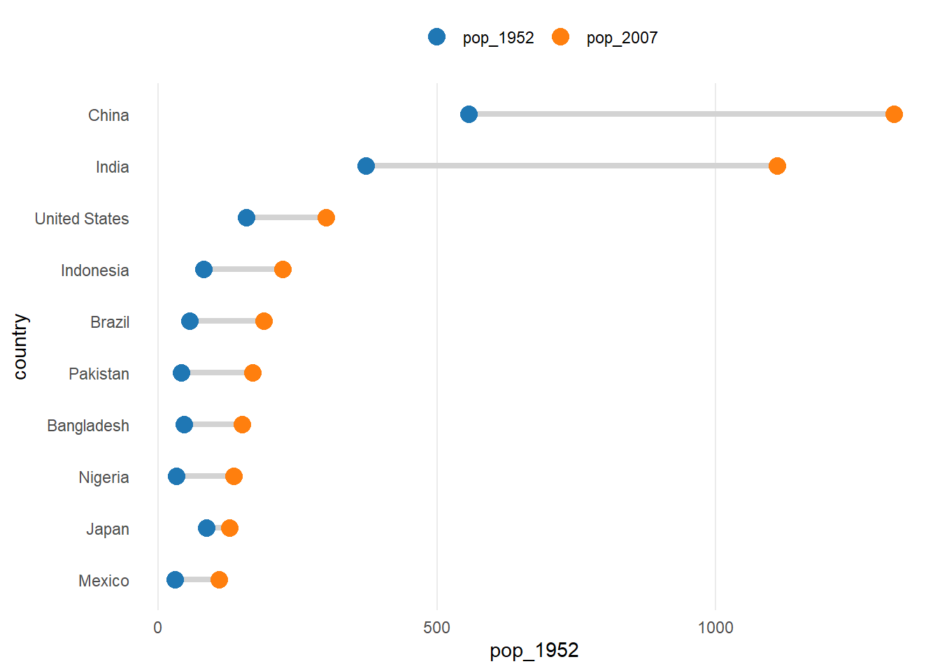
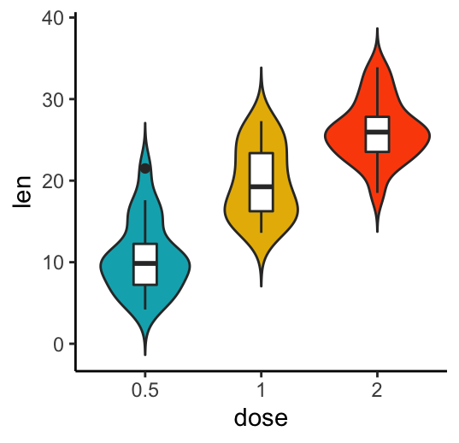
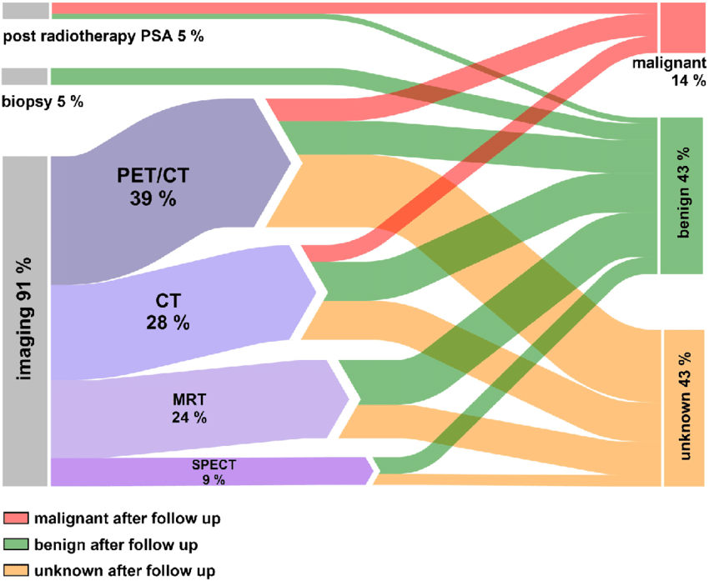
6.4. Figures: find the right figure for the right data
But don’t shy away from experimenting a bit!

Slide 22
Questions?
Presentation + other resources:
lsanchezpinto@luriechildrens.org

